Slide 1
Real Time Monitoring with Power BI

Slide 2

About You
Data centric or at least data adjacent role
Ask or have been asked
WHAT HAPPENED?
WHEN DID THIS HAPPEN?
https://www.flickr.com/photos/britishlibrary/11289228893/in/album-72157638906393085/

Slide 3

About Me
Bill Fellows
Principal Consultant Sterling Data Consulting
Microsoft Data Platform MVP 2014 – 2019
Loves SSIS, TSQL, Python, problem solving
Here to help
Bill.fellows@sterlingdataconsulting.com
816.200.7682
https://www.flickr.com/photos/britishlibrary/11288301815/in/album-72157638906393085/

Slide 4
Mise en place
Create a Power BI account if you don't already have one. It's free.
If you want someone else to see your report, you will need a Power BI Pro license, which is $10 a month.
You can only create streaming datasets and the dashboards that consume them via the PBI Service, aka powerbi.com
Microsoft Power BI Desktop (aka MSI)
Power BI Desktop (Universal App via windows store)

Slide 5
Outline
Identify Issue
Capture Criteria
Establish Endpoint
Dashboard Design
Stream
Issue
Criteria
Endpoint
Dashboard
Stream

Slide 6

Problem Domain
What does “real time” mean
Is it really real time? Really really?
Data generation frequency
Pump up the volume
https://www.flickr.com/photos/britishlibrary/11287749756/in/album-72157638906393085/
Issue
Criteria
Endpoint
Dashboard
Stream
Notes:
Speed of your car, credit card transaction processing, dynamic pricing, sensor readings, texting, maps
Quantify things. Frequency of data being generated? How many data points in a generation?

Slide 7

Criteria
What metrics matter?
https://www.flickr.com/photos/britishlibrary/11303067153/in/album-72157638906393085/
Issue
Criteria
Endpoint
Dashboard
Stream
Notes:
Speed of your car, credit card transaction processing, dynamic pricing, sensor readings
Quantify things. Frequency of data being generated? How many data points in a generation?

Slide 8

Establish Endpoint
Define the shape
Primitive types: string, datetime, floating points
https://www.flickr.com/photos/britishlibrary/11304246774/in/album-72157638906393085/
Issue
Criteria
Endpoint
Dashboard
Stream
Notes:
Floating point – only
Datetime must be zulu format

Slide 9
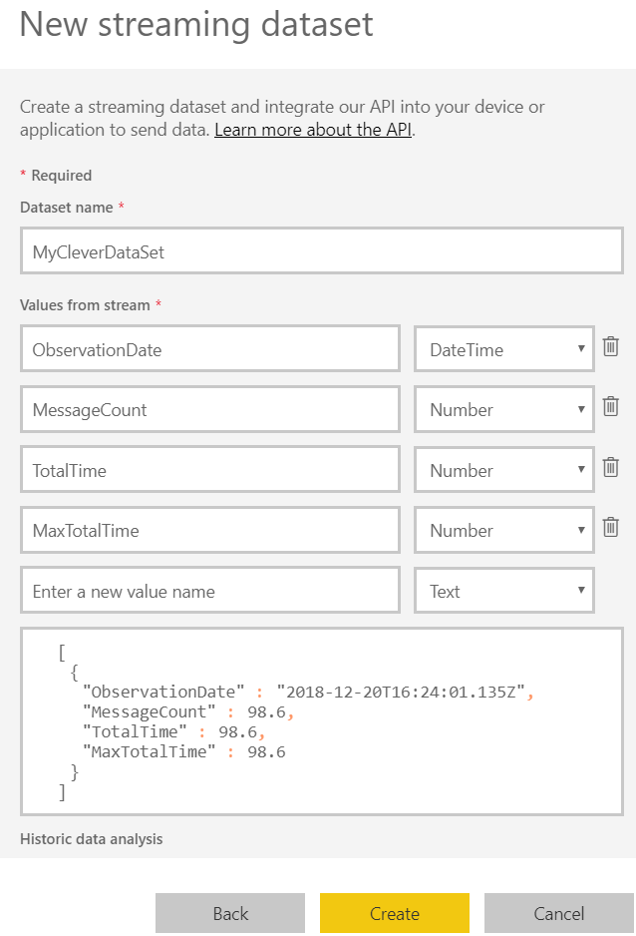
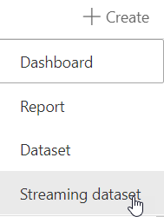
Establish Endpoint
Issue
Criteria
Endpoint
Dashboard
Stream
Notes:
Speed of your car, credit card transaction processing, dynamic pricing, sensor readings
Quantify things. Frequency of data being generated? How many data points in a generation?

Slide 10
Dashboard Design
You get what you get and you don’t pitch a fit
https://www.flickr.com/photos/britishlibrary/11303067153/in/album-72157638906393085/
Issue
Criteria
Endpoint
Dashboard
Stream
Notes:
I hope you like what you get because that’s it
No control for scale
No filtering, you send it, you get it

Slide 11

Stream
All you can eat, as long as you don’t eat too much
No incantations required
But possibly considered helpful
https://www.flickr.com/photos/britishlibrary/11303446793/in/album-72157638906393085/
Issue
Criteria
Endpoint
Dashboard
Stream
Notes:
Sample code provided, ish, when you establish the endpoint
https://docs.microsoft.com/en-us/power-bi/service-real-time-streaming

Slide 12
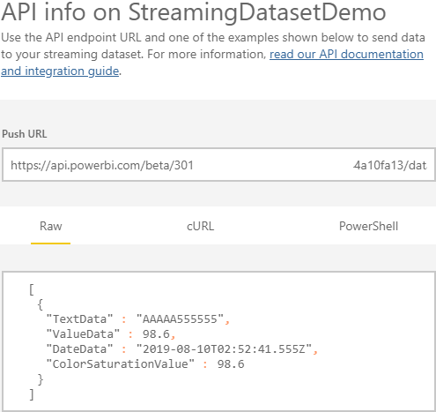
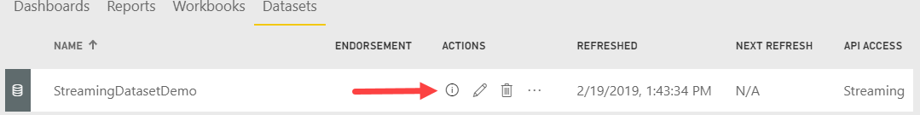
Stream

Slide 13

Take aways
Lots of open items on UserVoice
Talk to your neighbors
Visit the sponsors
Patch your servers
https://www.flickr.com/photos/britishlibrary/11169538475/in/album-72157638906393085/

Slide 14

https://www.flickr.com/photos/britishlibrary/11302069825/in/album-72157638906393085/
https://www.flickr.com/photos/britishlibrary/11169538475/in/album-72157638906393085/

Slide 15


https://www.flickr.com/photos/britishlibrary/11130437034/in/album-72157638906393085/
https://www.flickr.com/photos/britishlibrary/11144964175/in/album-72157638906393085/

Slide 16

https://www.flickr.com/photos/britishlibrary/11142674924/in/album-72157638906393085/

Slide 17
Issue
Criteria
Endpoint
Dashboard
Stream
Issue
Criteria
Endpoint
Dashboard
Stream
Issue
Criteria
Endpoint
Dashboard
Stream
Issue
Criteria
Endpoint
Dashboard
Stream
Issue
Criteria
Endpoint
Dashboard
Stream
Issue
Criteria
Endpoint
Dashboard
Stream

